Slide 1
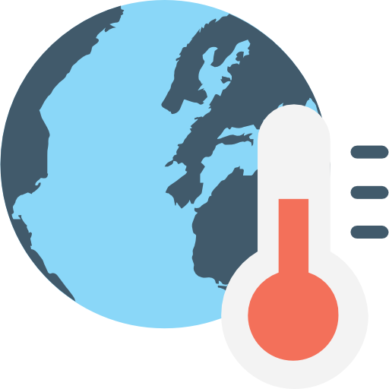
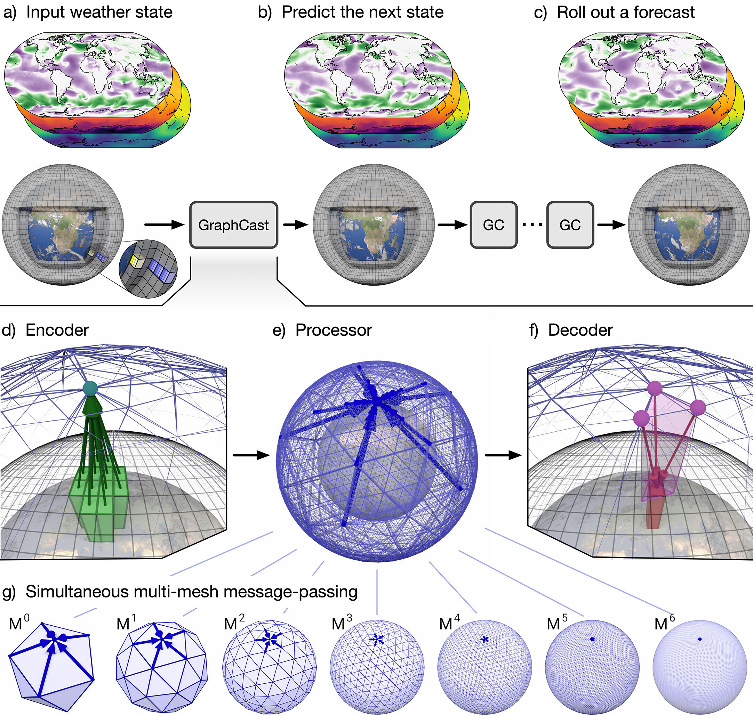
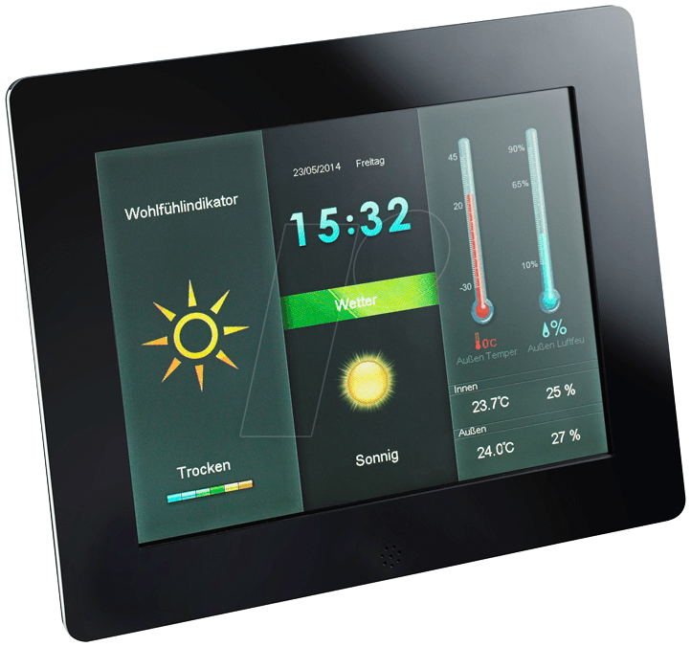
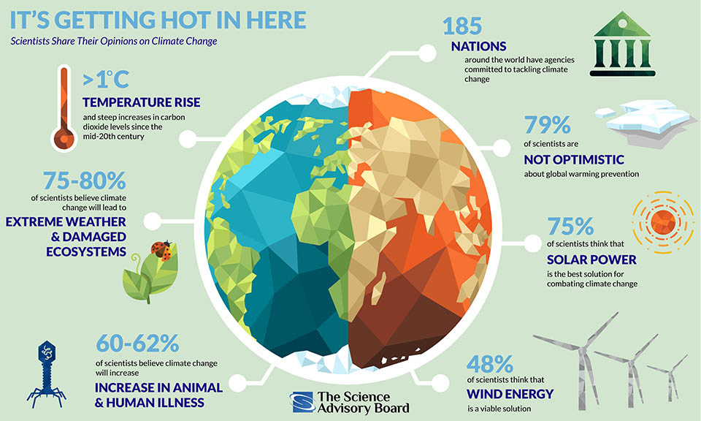
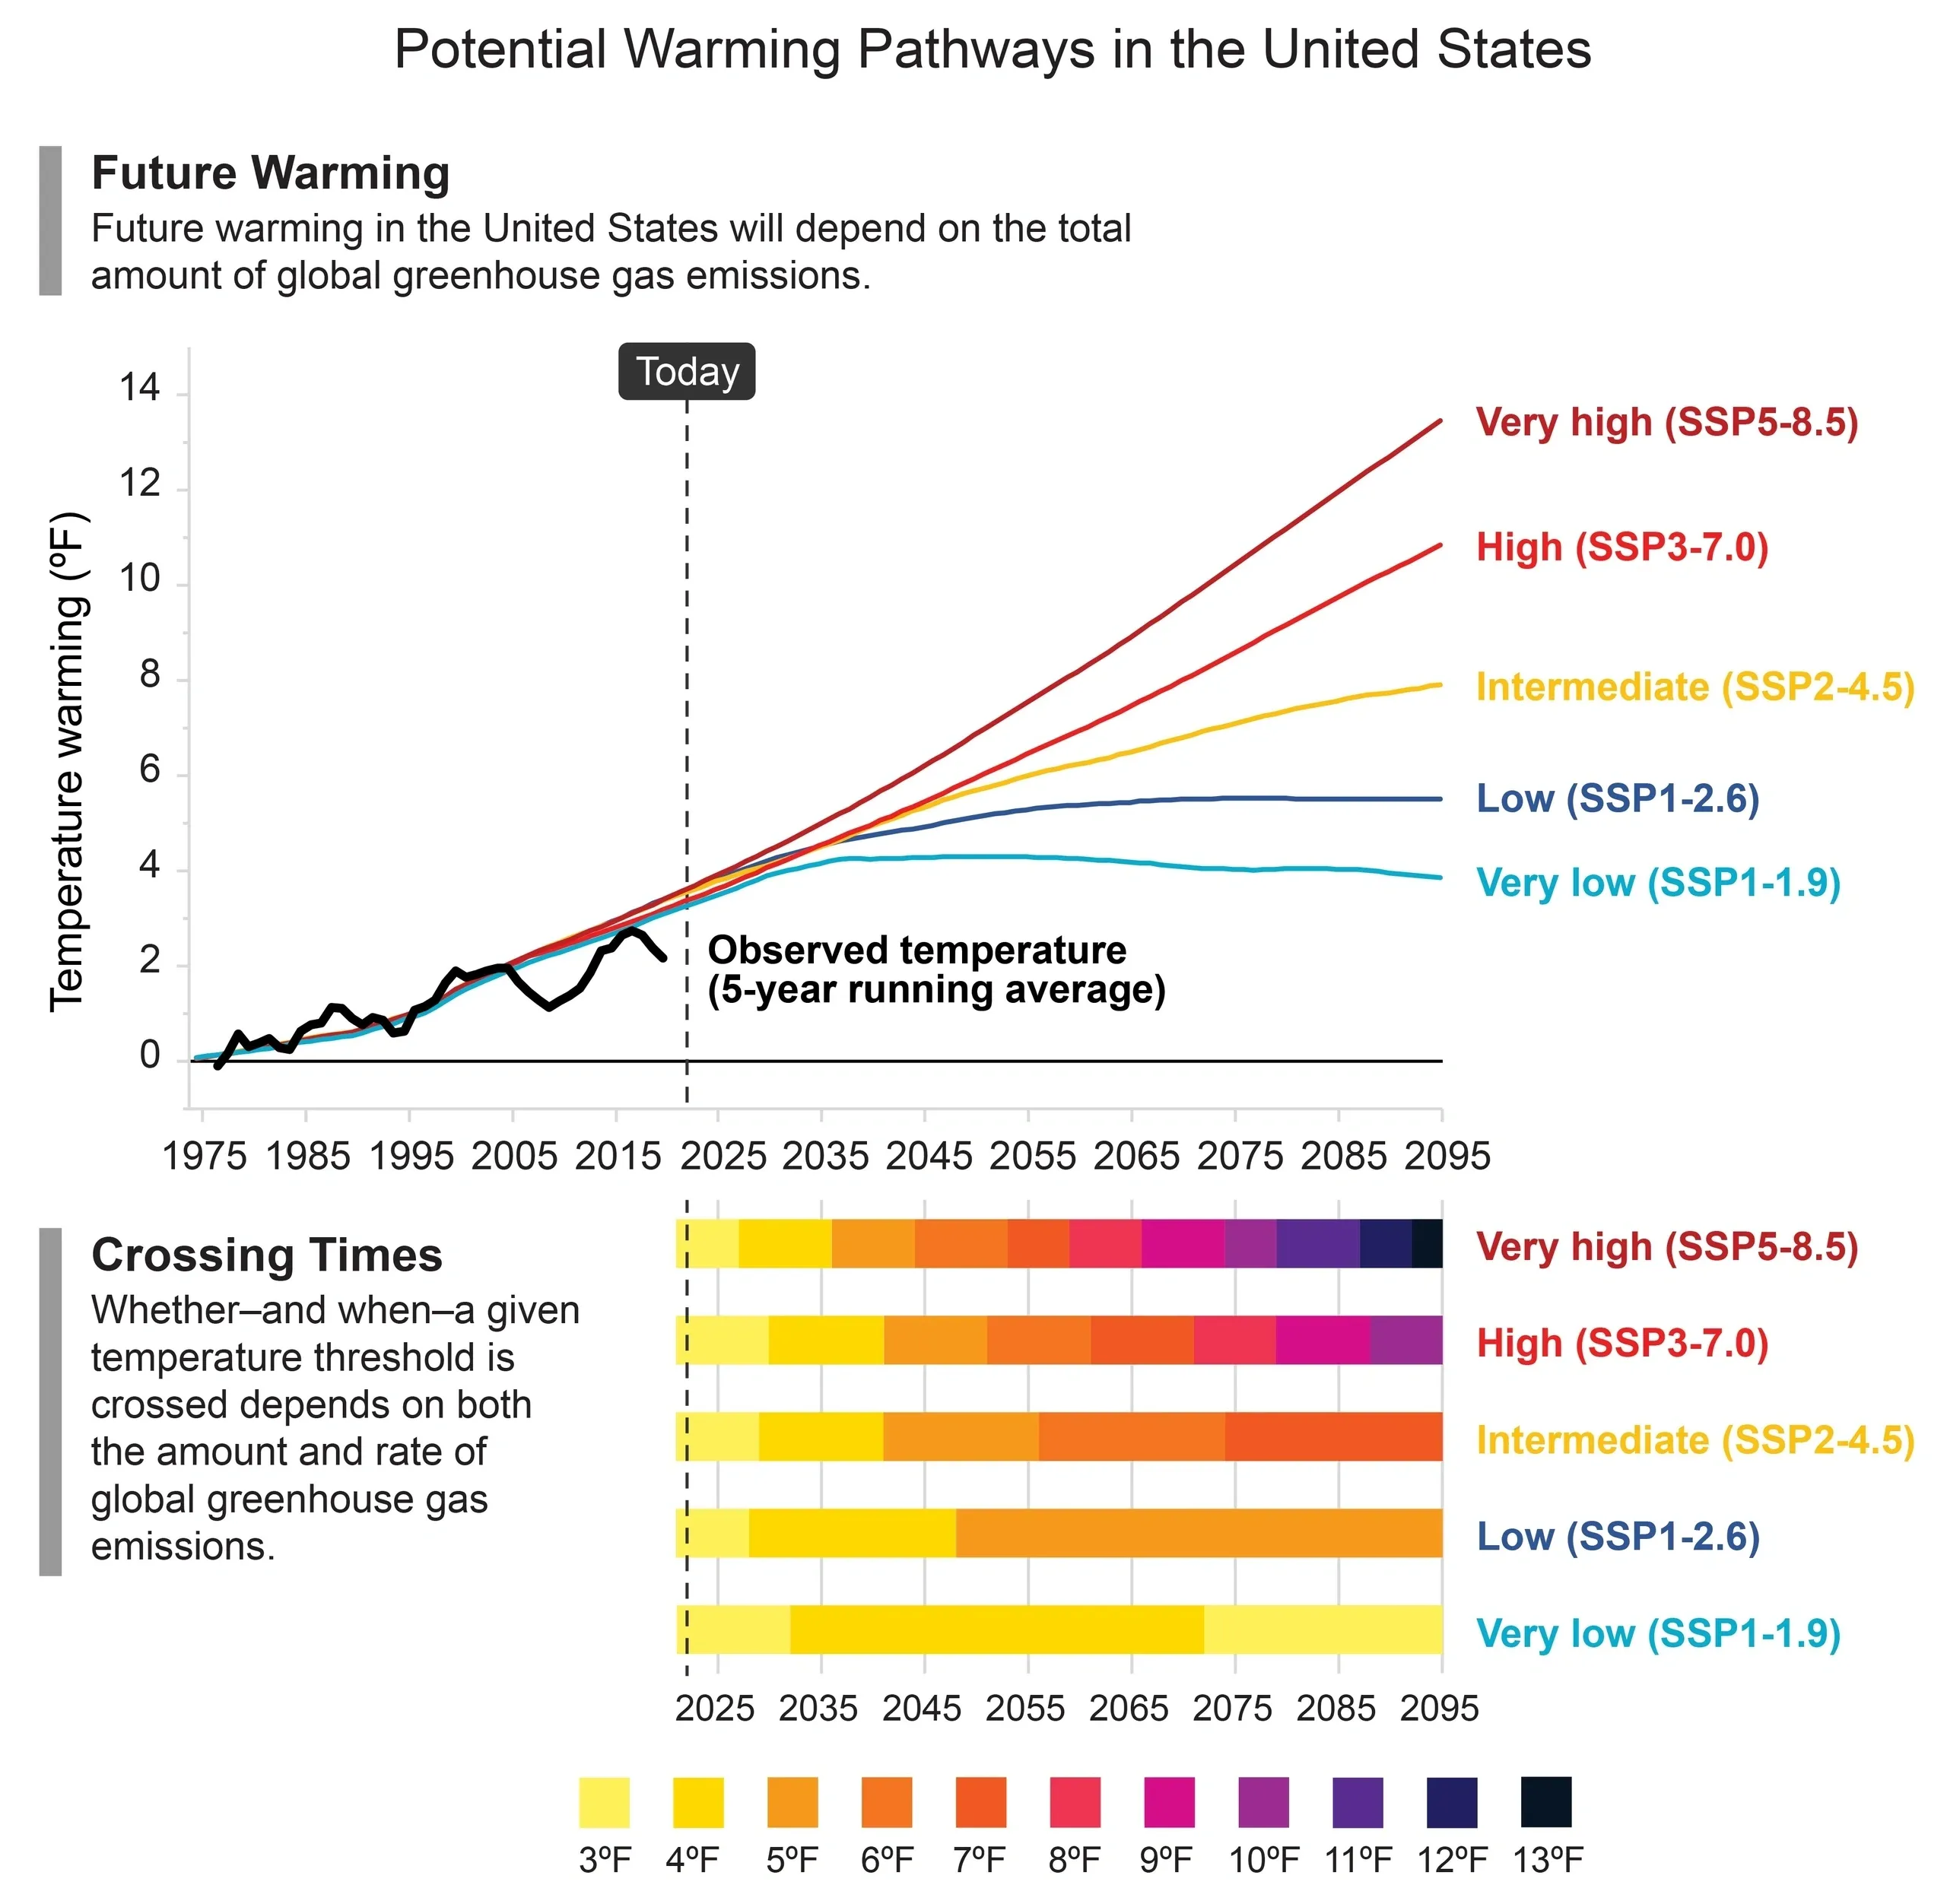
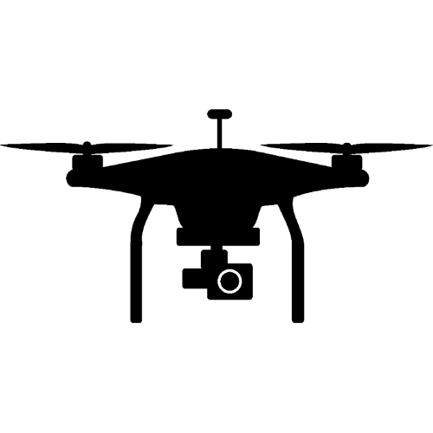

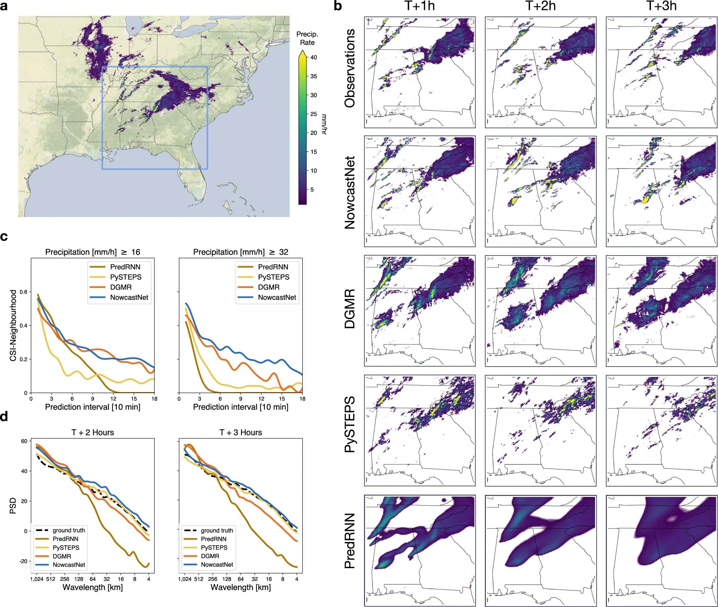
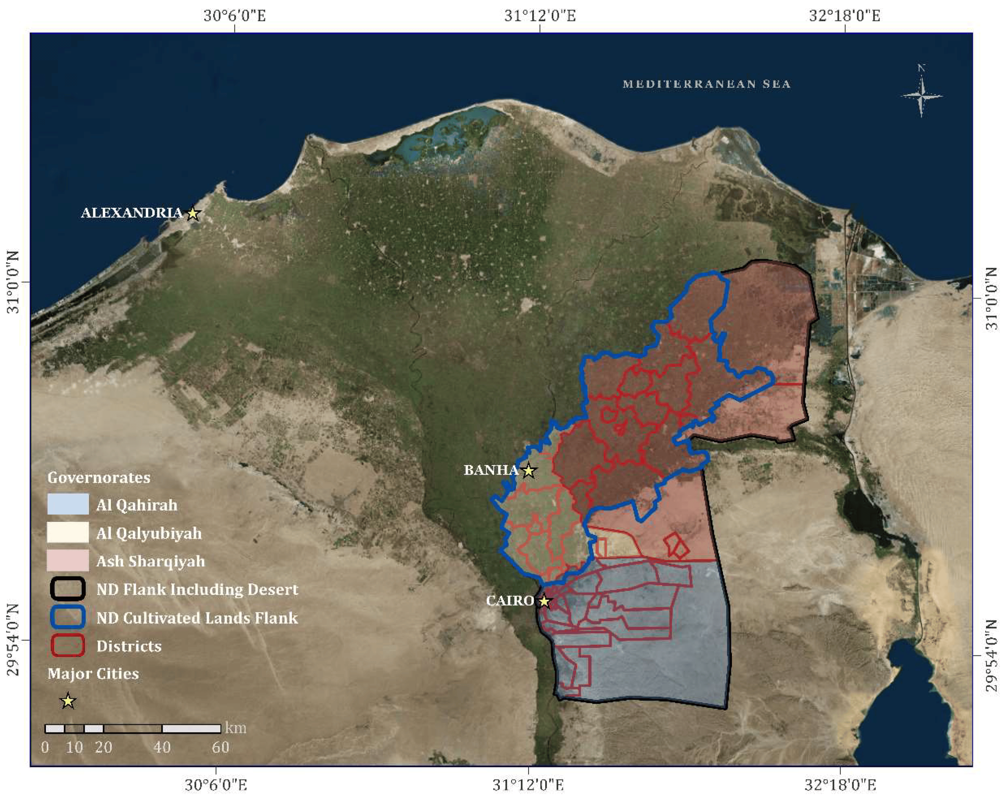


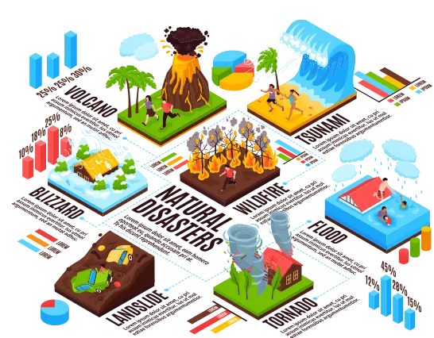




Technology-driven solutions to tackle climate change
Introduction
Climate change presents significant global challenges, demanding urgent adaptation and mitigation strategies. Advanced technologies offer promising solutions. Artificial Intelligence enhances climate models for accurate predictions and optimizes energy usage in smart grids, reducing carbon footprints. The Internet of Things enables real-time environmental monitoring, leading to more efficient energy consumption. Drones provide critical data for environmental monitoring.
Conclusion
AI improves predictive accuracy and optimizes energy usage, reducing greenhouse gas emissions and enhancing disaster management
IoT enables real-time environmental monitoring and resource management. Sensors in urban and rural areas provide continuous data on air quality, soil moisture, and temperature.
Drones are vital for environmental monitoring and disaster response, offering detailed imagery and data on deforestation, land degradation, and disaster areas.
AR and VR enhance public awareness, education, and training for climate adaptation. They create immersive experiences to visualize climate impacts for emergency responders.
Innovating and implementing these technologies enhances our capacity to adapt to and mitigate its impacts, promoting environmental sustainability and offers a comprehensive approach to tackling climate change.
Enhanced Predictive Accuracy:
AI models have improved the accuracy of climate predictions, enabling better preparation and response to extreme weather events. This reduces the socio-economic impacts of climate-related disasters.
Environmental Monitoring and Restoration:
Drones provide detailed imagery and data for monitoring deforestation, land degradation, and disaster-affected areas, facilitating targeted conservation and restoration efforts.
Results
Real-Time Monitoring and Response:
IoT sensors provide continuous monitoring of air quality and environmental conditions, allowing for immediate responses to pollution spikes and other climate hazards.
Method
Artificial intelligence Data Collection:
AI algorithms analyze vast climate data from satellites using machine learning to predict climate patterns.
IoT for Climate Monitoring:
IoT sensors monitor air quality, soil moisture, and temperature in real-time to improve efficiency.
UAV Technology for Environmental Monitoring:
Drones equipped with sensors monitor deforestation, land degradation, in disaster areas for rapid response.
Augmented Reality (AR) and Virtual Reality (VR):
AR and VR simulate climate scenarios, helping visualize impacts on communities and infrastructure, while educating the public and policymakers about climate risks.
Further Information
World Economic Forum (WEF):
The WEF provides extensive resources on the role of AI, IoT, drones, Earth observation, and AR/VR in climate adaptation.
Intergovernmental Panel on Climate Change (IPCC):
The IPCC produces comprehensive assessments on climate change science, impacts, and mitigation strategies
Public Awareness and Education:
AR and VR simulations create immersive experiences that educate the public and policymakers about the impacts of climate change and the importance of adaptation strategies.
Acknowledgment
We extend our gratitude to the individuals and organizations who contributed to the faculty and staff at the College of Arts, Technology, and Environment at UWE Bristol for their support and guidance. We thank the World Economic Forum for their insights into AI and climate adaptation technologies, and acknowledge the data and resources from UK Research & Innovation (UKRI), the Intergovernmental Panel on Climate Change (IPCC), and various environmental monitoring agencies..
Literature Cited
UK Research & Innovation (UKRI)-UKRI Climate Resilience Program.
Climate Technology Centre and Network (CTCN)-Technology Transfer for Climate Change Adaptation.

Slide 2
Student’s name:
Identification number:
Reference:
Kauffman, S. (2021) 'Harnessing AI for Climate Change Mitigation', Journal of Environmental Management, 287, pp. 112-123. doi:10.1016/j.jenvman.2021.112123.
Ahmed, F., and Zhang, Y. (2020) 'The Role of IoT in Climate Change Monitoring', Environmental Science & Technology, 54(14), pp. 9112-9121. doi:10.1021/acs.est.0c00324.
Liu, J., and Zhou, X. (2019) 'Satellite Remote Sensing for Climate Change Research', Remote Sensing of Environment, 232, pp. 111-123. doi:10.1016/j.rse.2019.111123.

